Slide 1
YELP DATA challenge
Shiqing Chen, Jahnavi Nadipi, Wenliang Sun, Jiaru Zhu

Slide 2
Introduction
Suppose you graduated from Penn State, and want to start a local business because you are prohibited to type codes out of the classes.
Then, what kind of business? A barber shop? A restaurant? A pub? A café de nerd??.......
OK, you decided to open a restaurant. What cuisine? American? Indian? Chinese? Rubbish food??......
You will just have too many questions to ask….
BUT you have us!!! Our goal is to find a trend from the YELP dataset for the businesses that are gaining more popularity than others.

Slide 3
Related Work
1. https://courses.cs.washington.edu/courses/cse544/13sp/final-projects/p09-tingtinz.pdf(visualize some user and business behaviors)
2.https://pdfs.semanticscholar.org/130e/cc92626b32b89a27dbcda7357cd4b18abdc5.pdf(predict a business star)
3.https://www.researchgate.net/publication/303331726_Yelp_Dataset_Challenge_Review_Rating_Prediction(review rating prediction)
4. https://cseweb.ucsd.edu/~jmcauley/cse190/reports/sp15/003.pdf(using text mining to predict rating)
5. http://people.hbs.edu/mluca/Yelp.pdf(how online customer review affect restaurant demand)

Slide 4
Problem Description
Data mining can be very useful to help people decide. Especially when your resources are very limited, and you have to maximize the efficiency of your investments. Thus, our analyzed data results can greatly increase the probability that your investment of time and money will be well justified.
The first assumption in this project is to make a direct connection between the success of your business and the popularity of your business. Success is defined as both being profitable and being recognized. Popularity is defined as a numerical score that the larger the absolute value the more significant in the trend of popularity, and positive numbers mean increasing popularity while negative numbers mean decreasing popularity. We will define more details in the project later on.

Slide 5
Problem Analysis
First of all, we need lots of data. As we are looking for a trend in the dataset, we would pull past datasets too. On the official yelp data challenge website, only the current dataset can be downloaded, but we found some Github posts that contain past datasets. At least 5 datasets that are 6 months older than the previous are required in this project.
Secondly, once we get the datasets, and we prefer the JSON format, we will research all the attributes as well as the structure of the datasets.
Thirdly, we will analyze the attributes, and perform a supervised machine learning to find the weights of features that are related to the trend of popularity.
Finally, the decision making will be fine tuned based on a local survey to the popular business. A ROC curve will also be analyzed to improve the accuracy.

Slide 6
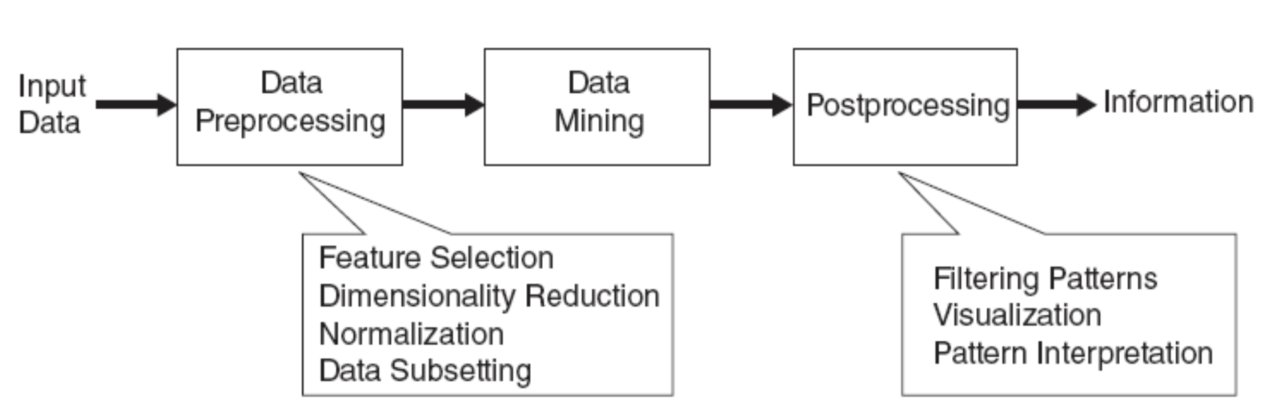
Initial ideas

Slide 7
Data Propressing
Data From Yelp: (1)Noise
(2)Outliers
(3)Missing values
(4)inconsistent values
(5)Duplicate data
Propressing Methods:
(1)Aggregation
(2)Sampling (3)Dimensionality Reduction (4)Feature subset selection (5)Feature creation (6)Discretization&Binarization (7)Attribute Transformation

Slide 8
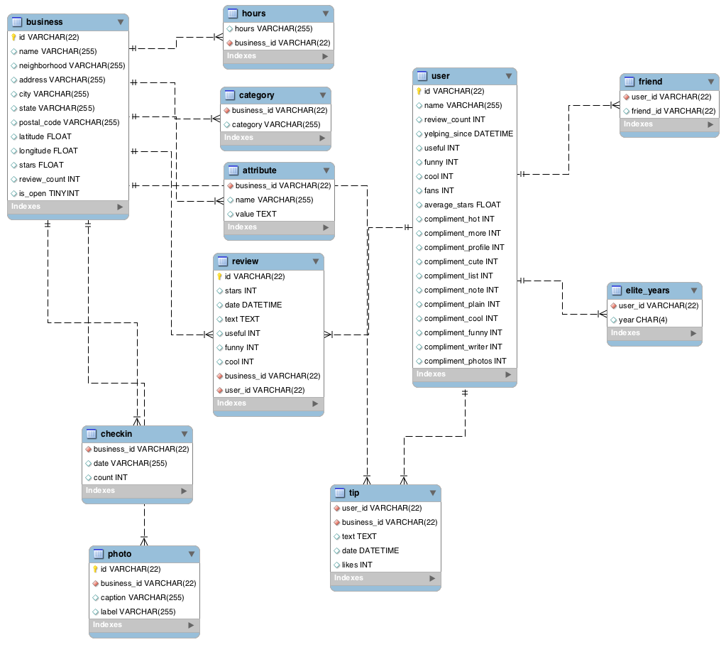
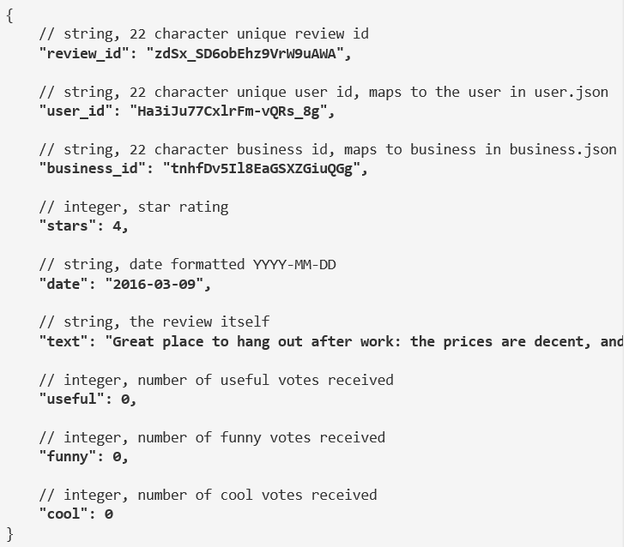
Datasets

Slide 9
Timeline
Week 0 -1: Pull datasets, and analyze the attributes.
Week 2-3: Research the appropriate data mining algorithms as well as the best machine learning methods for our project.
Week 4: Progress report and team binding meetings.
Week 5-6: Run algorithms on datasets multiple times. Change the granularity of the supervised machine learning, and tune to the best results possible before surveying.
Week 7-8: Perform a local survey on popular businesses, and further tune the threshold to meet the best accuracy.
Week 9: visualize results, and prepare the final presentation.

